Slide 1
LING 392: Nature of Language & Language Acquisition
Sarah Alnazer
Dr. Thao

Slide 2
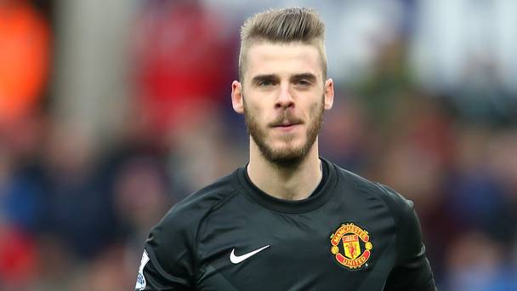
David De Gea
A Spanish soccer player, plays a goalkeeper for English club Manchester United and the Spain national team.

Slide 3
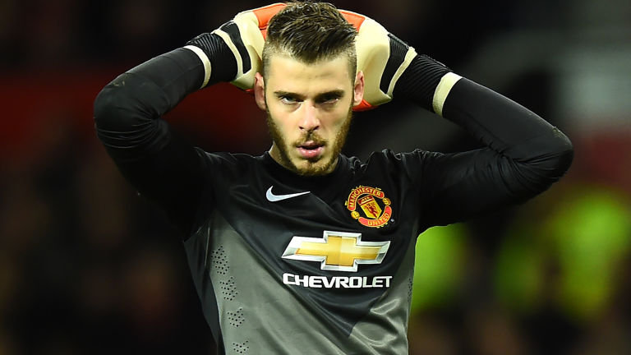
Video☺
https://youtu.be/vQt0dRN-xB0?t=41s

Slide 4
Phonology
De Gea tends to use the tense, rounded [o] instead of the lax, unrounded vowel.
- [wos] → was
[clob] → club
[som] → some
[t] voiceless alveolar.
- [momen] → moment
- [wan] → want
[d] voiced alveolar.
[an] → and

Slide 5
Spanish: pronunciation:
- [leyends] → legends : the voiced [dʒ]
https://youtu.be/vQt0dRN-xB0?t=4m5s
- [season] → the 2nd [s] : the voiced fricative alveolar [z]
https://youtu.be/vQt0dRN-xB0?t=4m40s

Slide 6
Morphology
(1) how I feel that [momen] [an] it was unbelievable. → felt.
(6) when I came I [wos] bit skinny than now and I works a lot and hard the gym → worked. (needless plural suffix)
https://youtu.be/vQt0dRN-xB0?t=2m5s
(13) And I fell stronger on that [momen] and keep my work hard till now → felt.
https://youtu.be/vQt0dRN-xB0?t=3m15s

Slide 7
Syntax
use filler words: “uh”
(6) uh it was difficult for me and of course when …
(8) I have to come back to Spain o another place. The weather, the language uh, I dunno it was difficult moments
https://youtu.be/vQt0dRN-xB0?t=2m28s

Slide 8
Syntax (cont.)
2. repeat some words in a phrase
(4) how they support me when when everything the the thing was bad, bad things and we lose some games and they are always there they sopport the team.
https://youtu.be/vQt0dRN-xB0?t=1m27s
(18) I think we we create many chances in in the games,
https://youtu.be/vQt0dRN-xB0?t=4m24s

Slide 9
Syntax (cont.)
(19) but I think we are not not looking on [som] games like Newcastle.
(20) We should win this this game but we are not looking on the moment,
(21) I think we defend better than than the last sea[s]on.
https://youtu.be/vQt0dRN-xB0?t=4m29s

Slide 10
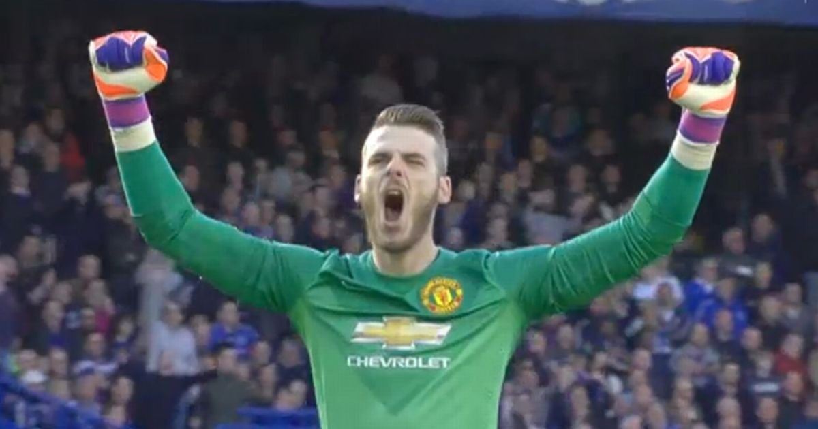
Semantics ☺

Slide 11
THANK YOU
Questions ? Comments.

