Slide 1
The Linguistic Relationship between Arabic and Spanish
Sarah Alnazer
Advisor: Dr. Gabriela C. Zapata

Slide 2
Organization of Presentation
Objective of the study
The Arabic presence in Spain
The linguistic influence of Arabic on Spanish
The current presence of Spanish in Northern Africa

Slide 3
Objectives of the Study
The main objectives of this project are to:
Investigate the historical and linguistic relationship between Arabic and Spanish;
Analyze the linguistic phenomena that have resulted from the linguistic contact between these two languages throughout history;
Describe the current presence of Spanish in Arabic-Spanish bilingual communities in Morocco, focusing on the sociolinguistic aspects that distinguish them.

Slide 4
The Arab Presence in the Iberian Peninsula
The Battle of Guadalete: a battle between the Visigoths and the Arabs.
In 711, the Arabs began the conquest of the Iberian Peninsula, bringing about the beginning of a new linguistic and cultural era.

Slide 5
The Arab Presence in the Al-Andalus
Andalusia was a name given by the Arabs to the area under their control.
The spoken languages in Andalusia were
Arabic.
Romance dialects (derived from Latin)
Hebrew (among the Jewish population)

Slide 6
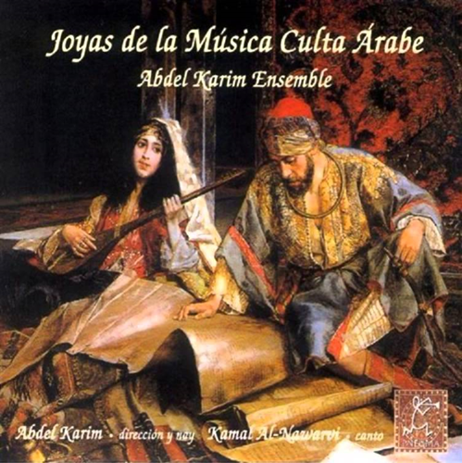
The Linguistic Influence of Arabic on the Romance Dialects
The inhabitants of Andalusia continued to use the Romance dialects (precursors of Modern Spanish) spoken at the time of the Arab arrival, but also many adopted Arabic and used it in formal contexts.
A concrete example of the coexistence of the two languages are the so-called Jarchas, lyrical compositions in Arabic with words from Romance dialects.

Slide 7
The Linguistic Influence of Arabic on the Romance Dialects (Cont.)
Jarcha comes from the Arabic word (خرجة: jarya) which means “end" or "final.” These compositions were written in Arabic script, but most of the language used is Romance (Early Spanish) (Nadeau & Barlow, 2013).
Example (the Romance words are in bold):
1 b’n sydy b’n → Ven sidi veni
2 l’qrd’s tntb’n → El querido es tan ben
3 dst ‘lzm’n → De este al-zameni
4 bn flyw dbn ‘ldy’n → Ven filyo de Ben al-Dayyeni.
Interpretation:
1 Ven dueño mío, ven, (Come my lord, come)
2 porque el amor es un gran bien (Because the love is so great)
3 que nos depara esta época (which holds this time for us)
4 ven , hijo de Ibn al-Dayyan (Come, son of Ibn al-Dayyan)
Notes:
Words from Romance languages:
ben → ven: come (From Basque: the loss of the distinction between "b" and "v")
Flyw → hijo: son (From latín “filiu”)
Dst → de este: from this.
Words from Arabic language:
Sydy which means “master”/ “lord”.
Lzm’n which means “time”/ “period”.

Slide 8
The Linguistic Influence of Arabic on Spanish (Cont.)
I. Phonology
The Arabic velar voiceless sound /k/ represented by the letter "q" is replaced by the palatal voiceless sound /k/ and the written letter "c" in Spanish.
E.g.: al-aqrab → alacrán (scorpion)
The Spanish fricative labiodental /f/ sound replaces the Arabic phoneme /χ/ (written as kh).
E.g.: al- khilal → alfiler (pin) (Goetz, 2007, p. 78)

Slide 9
The Linguistic Influence of Arabic on Spanish (Cont.)
II. Morphology
The suffix –í appears in nouns and adjectives that mostly come from Arabic to form nouns and adjectives that denote place of origin.
E.g.:
marroquí de Marruecos (Moroccan from Morocco)
andalusí del Ándalus (Andalusian from Andalusia)

Slide 10
The Linguistic Influence of Arabic on Spanish (Cont.)
III. Syntax
a. The influence of the article /Al/ and its various manifestations. In Arabic, the consonants are divided into two groups:
The sun letters or solar letters: The article “Al” is written, but not pronounced. | The moon letters or lunar letters: The article “Al” is written and pronounced.
Assukar → Azúcar (sugar) Azzayt → Aceite (oil) (Noll, 2006) | Al-kohol → Alcohol (alcohol) Al-qoton →Algodón (cotton)

Slide 11
The Linguistic Influence of Arabic on Spanish (Cont.)
b. “Hasta” حتى → from Arabic “hatta,” which has the same meaning of the Spanish preposition “hasta.” Both indicate the duration of an event or action, giving a specific time of completion or ending.

Slide 12
The Linguistic Influence of Arabic on Spanish (Cont.)
c. The indefinite nouns “fulano,” “mengano,” and “zutano,” which are all used to designate a person whose name is unknown or who do not want to mention (Dyke, 1983). They’re akin to the English so-and-so, what's-his-name, what's-her-name, or Tom, Dick, and Harry. señora fulana de tal Mrs.
E.g.:
No me interesa si paga fulano, mengano, o zutano, lo que me interesa es cobrar.
I do not care who pays me, what interests me is getting my money back.

Slide 13
The Linguistic Influence of Arabic on Spanish (Cont.)
IV. Semantics
About 4000 words in Spanish are of Arab origin.
Examples from different semantic (conceptual) fields.
Knowledge and science:
a. “Cero” (zero): From Arabic sifr "empty"
b. “Álgebra” (algebra): From Arabic الجبر gabr "reduction”
c. “Jarabe” (syrup): From Arabic شراب sharab (in Spanish it is used in medicine)
(Nadeau & Barlow, 2013)

Slide 14
The Linguistic Influence of Arabic on Spanish (Cont.)
Agriculture and cuisine:
“Alcachofa” (artichoke): From Arabic خرشوف haršuf
“Zanahoria” (carrot): From the Moroccan Arabic word isfannãriyya
Alubia (type of bean): From Arabic al-lúbiyā
Aceituna (olive): From Arabic الزيتون‎ az-zaytun
Naranja (orange): From Arabicنارنج: nāranǧ.
Albóndiga (similar to a meat ball): From Arabic al-bundiqa
(Rorabaugh, 2010)

Slide 15
The Linguistic Influence of Arabic on Spanish (Cont.)
Names of places:
Guadalajara from the Arabic Wadi Al-hidjara: a combination of two words: wadi + alhijara which means “the river that runs through the stones”
Guadalquivir from the Arabic Al-wadi Al-kabir which means “the big river”
Guadalupe from the Arabic Wadi-al- lub: a combination of the Arabic wadi and the Latin lupus, which can be interpreted as “river of the wolf”
Madrid from the Arabic al-magrit which means “spring”
(Resnick, 1981)

Slide 16
The Linguistic Influence of Arabic on Spanish (Cont.)
Home and comfort
a. Almohada (pillow): From Arabic almuhádda, derived from the word hadd.
b. Alfombra (carpet/rug): From Arabic alhúmra.
5. Architecture and construction
a. Adoquín “(cobble): From Hispanic Arabic addukkán or addukkín.
b. Albañil (builder): From Hispanic Arabic albanní
c. Azulejo (tile): From Hispanic Arabic azzuláyg[a]
(Rorabaugh, 2010).

Slide 17
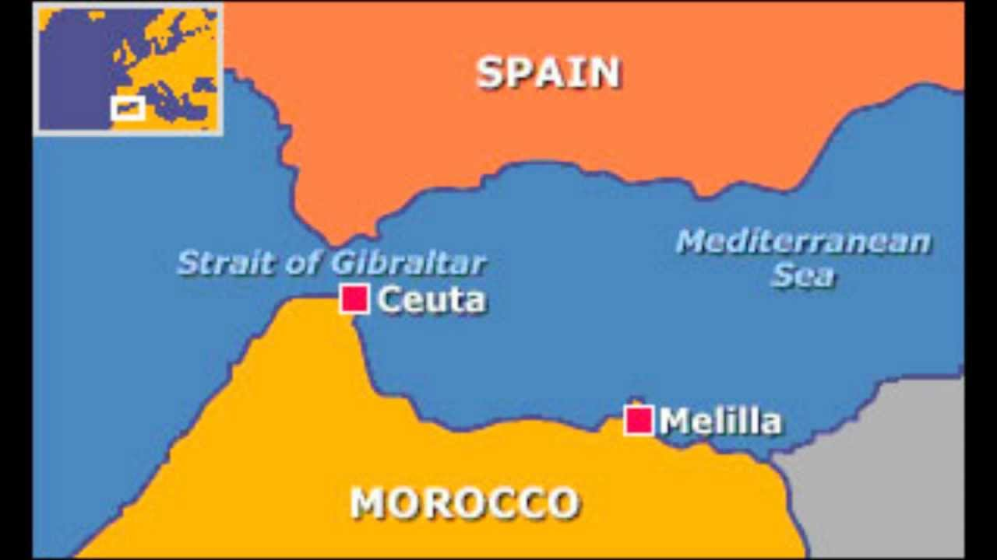
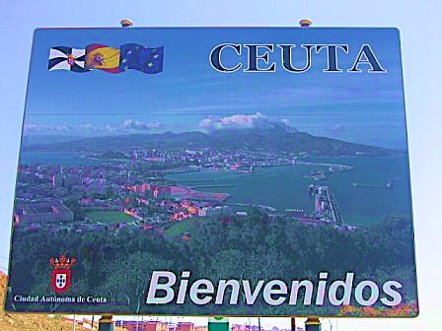
The Spanish Presence in Modern Morocco
La Berbería: The Spaniards established themselves in Melilla in 1497 and in Ceuta in 1668.
Today, both cities remain part of Spain as “ciudades autónomas” (autonomous cities).
Ceuta: The most important Arabic-Spanish bilingual area.
Spaniards living there: mostly monolingual;
Moroccans: Bilingual;
Spanish only official language;
Variety: Moroccan Spanish
(Sayahi, 2011b)

Slide 18
The Spanish Presence in Modern Morocco (Cont.)
Situation of diglossia: Arabic at home; Spanish at school/work.
Reverse situation: Spanish influencing Arabic:
Moroccan Spanish is the majority language, and Arabic, the minority one;
Due to this sociolinguistic situation, Moroccan Spanish has not been influenced by Arabic;
Moroccan-born Spaniards prefer to focus on Spanish rather than Arabic for prestige and pragmatic reasons (opportunities of jobs in mainland Spain);
They tend to want to disassociate themselves from a Moroccan identity;
Moroccans, on the other hand, embrace a bilingual identity, and both Spanish and Arabic (Sayahi, 2005).

Slide 19
The Linguistic Influence of Spanish on Arabic
Loan Words (Sayahi, 2011, p. 92)
Food: paella (typical rice and seafood dish), bocadillo (sandwich), merienda (afternoon snack)
Clothing: camiseta (T-shirt), chaqueta (jacket), sombrero (hat)
Names of fish (due to the presence of the Spanish fishing industry): atún (tuna), bacalao (cod)
Common nouns: This really shows how much influence Spanish has had in the area. These words have replaced the Arabic equivalents: amigo (friend), cama (bed), camarero (waiter)
Greetings that have been adopted into Arabic: hola (hi!), adiós (goodbye).

Slide 20
Conclusion
Spanish and Arabic have been in contact since the 8th century;
Arabic left an indelible imprint in all the varieties of Modern Spanish;
Now Spanish is influencing Arabic, and the two languages are again providing us with an excellent example of language contact which, I hope, will continue to be investigated in the future.

Slide 21
References
Dyke, C. E. (1983). Filosofía de la economía. Madrid: Paidós.
Goetz, R. (2007). La lengua española: Panorama sociohistórico. Jefferson, NC: McFarland & Company
Nadeau, J. B., & Barlow, J. (2013). The story of Spanish. Chicago: Macmillan.
Noll, V. (2006). La aglutinación del artículo árabe al en el léxico español. Cosmos Léxico, 14, 35-49.
Resnick, M. (1981). Introducción a la historia de la lengua española. Washington: Georgetown University Press.
Rorabaugh, D. (2010). Arabic influence on the Spanish language. Unpublished manuscript. Seattle Pacific University. Retrieved on April 20, 2016, from http://people.math.sc.edu/rorabaug/docs/ArabicInfluence.pdf

Slide 22
References
Sayahi, L. (2005). Language and identity among speakers of Spanish in northern Morocco: Between ethnolinguistic vitality and acculturation. Journal of sociolinguistics, 9(1), 95-107.
Sayahi, L. (2011). Contacto y préstamo léxico: El elemento español en el árabe actual. Revista Internacional de Lingüística Iberoamericana, 9(2), 85-99.
Sayahi, L. (2011b). Spanish in contact with Arabic. In M. Díaz-Campos (Ed.), The handbook of Hispanic sociolinguistics (pp. 473-490). Malden, MA: Wiley-Blackwell.

